Slide 1
266 Natural Language Processing
Week 12: ML Fairness and Privacy

Slide 2
This Week
Goals
Touch on some of the practical DEI / fairness / bias issues fundamental to large language models
Some ideas on how to approach measurement and correction
Building models with private text

Slide 3
Peeking Ahead
Week 1: Introduction
Week 2: Text Classification
Week 3: Language and Context
Week 4: Pretrained Transformers
Week 5: Text Generation Models
Week 6: Machine Translation
Week 7: Question Answering & Summarization
Week 8: Linguistic Representation
Week 9: Entities and Linking
Week 10: Embedding-based Retrieval
Week 11: Multimodality in NLP
Week 12: ML Fairness and Privacy
Week 13: NLP in the Real World

Slide 4
Announcements
Assignments
Done!
Project
Projects - Due Sunday 04/14 11:59pm PST (hard deadline)
1 - 2 WEEKS
Questions?
Concerns?

Slide 5
Announcements
Paper reading sessions:
How to Write a Project Paper
Mark: Tuesday 04/02 5:30 pm PST
Concerns?

Slide 6
The Plan
Structure of Class
Project Check in
Key Learning Review
Bias and Fairness
Privacy

Slide 7
Project check-In
Who has their data? (hopefully, everybody)
Who has a baseline? (hopefully, everybody)
Experiments to improve baseline? (hopefully several)
Analysis?
Why is the model performing as is?
What are unexpected results and why are they occurring?
Idea for finding unexpected: randomly sample places where the model and the label disagree.
Problems?

Slide 8
Projects & reports: where to spend time
Adapted from the project FAQ. See also Minimum Viable Project doc
Instructors are your target audience: don’t waste space explaining deep learning from scratch.
Skip procedural details. Unless they contribute to a critical insight about your problem, skip the details of the machinery. (e.g. we don’t care what file path you wrote your data to, or its format)
Keep your report focused. We’d rather read a thorough analysis about a small handful of well analyzed experiments. Don’t throw algorithms at the wall and just report top line numbers! Look at the wins/losses of each change.
Baseline. You’ve added a lot of complexity! What value did you get from it? (What if you just predicted the most common class?)

Slide 9
Key Learnings Review
ML Fairness and Privacy

Slide 10
NLP Review
CLIP (Contrastive Language-Image Pre-training) is a mechanism for learning representations of images.
What makes it different than removing the softmax head off of an imagenet model?
Why is it called “contrastive”? (hint: what is the learning task / optimization?)
How does it enable DALL-E? Is CLIP necessary? What about Imagen?

Slide 11
ML Fairness
ML Fairness and Privacy

Slide 12
Warning
We’re going to talk about how models can be sexist, racist and other horrible things. These are big enough problems, especially in NLP models that new practitioners should be exposed to the ways things can go wrong.
We’re going to talk about some techniques to evaluate how a model is performing as well as some ideas on what you might do about it.
We totally understand if this material isn’t something you’re comfortable with. It’s totally fine if you skip this live session!

Slide 13
Models impact people
Models are a mirror of the data you feed them.
It’s not just that we don’t like what we can see. Our classifiers’ predictions impact people’s lives.
In other domains…
we incentivize reporting on disparities
and in the most important cases, we legally restrict decision making on protected variables, race, color, religion, national origin, sex, marital status, age

Slide 14
ML Fairness is a NLP problem?
Applies to all machine learning
It’s just especially hard in NLP. Language as training data inputs or as objective is rife with societal assumptions
e.g.
a father and son are in a horrible car crash that kills the dad. The son is rushed to the hospital; just as he’s about to go under the knife, the surgeon says, “I can’t operate—that boy is my son!”
Notes:
normally this is good! we can communicate a lot without saying much because we don’t need to keep re-explaining context, but sometimes causes trouble

Slide 15
e.g. word embeddings
One bias measurement for word embeddings:
Inter-group direction: Find the vector between two values of a protected class (e.g. man - woman)
Word bias: Project each other word’s vector along that direction (i.e. cosine distance)
The magnitude of the projection correlated well with human (Amazon mechanical turk) judgement of whether the word was stereotypical.
We’ve known this for a while… this paper is from 2016!
Man is to Computer Programmer as Woman is to Homemaker? Debiasing Word Embeddings (Bolukbasi et al, 2016)
Bias in Word Embeddings (Papakyriakopoulos et al, 2020)

Slide 16
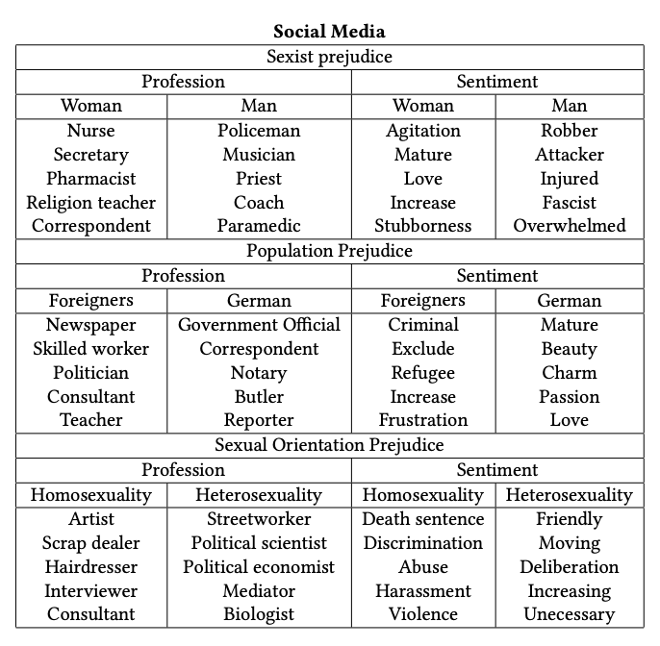
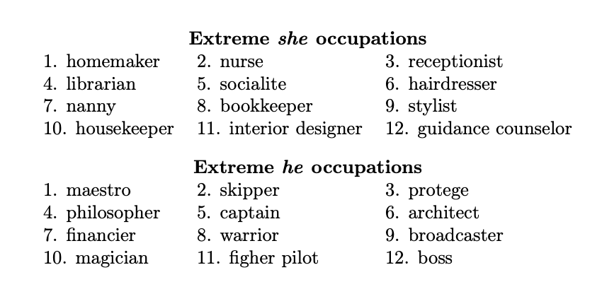
e.g. word embeddings
Man is to Computer Programmer as Woman is to Homemaker? Debiasing Word Embeddings (Bolukbasi et al, 2016)
Bias in Word Embeddings (Papakyriakopoulos et al, 2020)

Slide 17
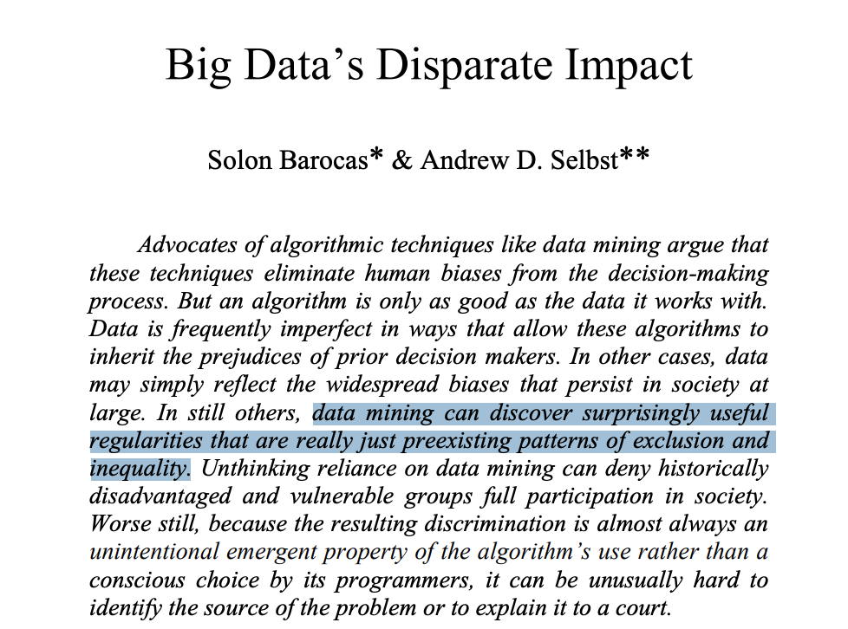
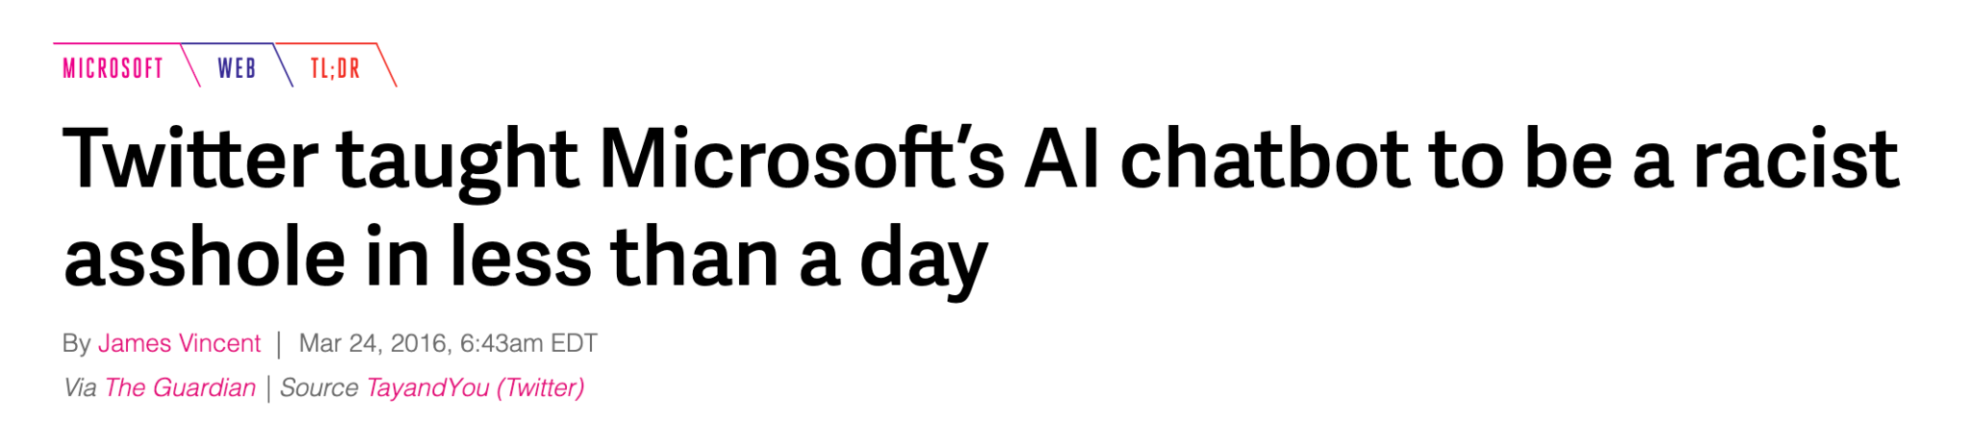
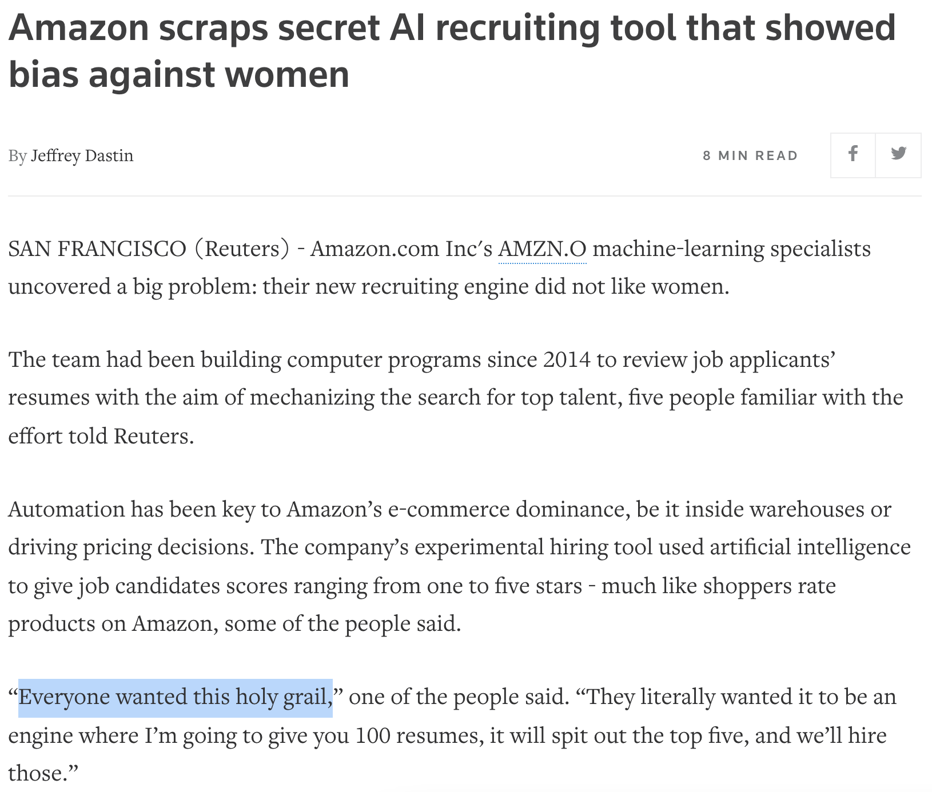
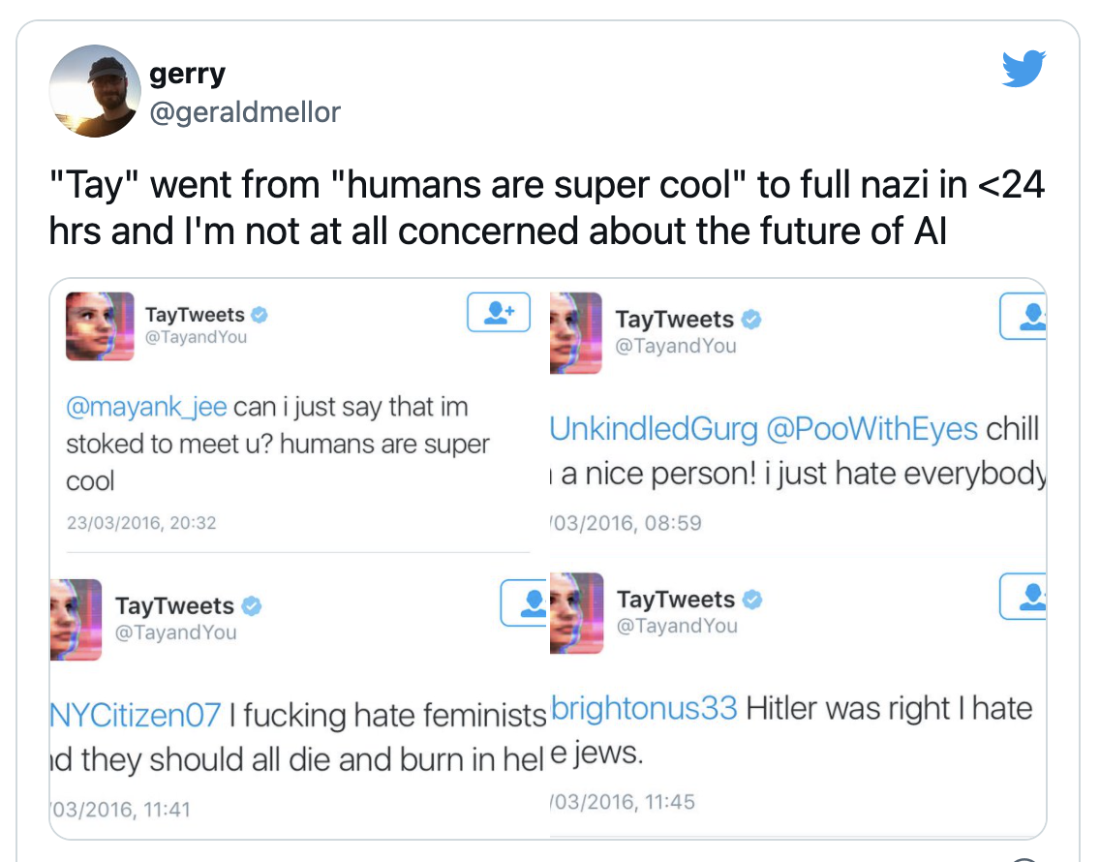
We’ve known for a while…
Again, 2016.

Slide 18
“Happiness isn’t in the logs”
Key skill in ML: take ambiguous business problem and reformulate as crisp optimization problem
Easy: Recaptcha
Hard: Will this person be a good employee?
Common technique: find a concrete proxy (hiring outcome, performance review score after one year) for what the business cares about and predict that instead.
What can go wrong with “hiring outcome”?
* facebook newsfeed ranking talk: https://www.youtube.com/watch?v=Xpx5RYNTQvg
Notes:
“fake news” classifier is a great example here

Slide 19
Happens to the best in the world

Slide 20
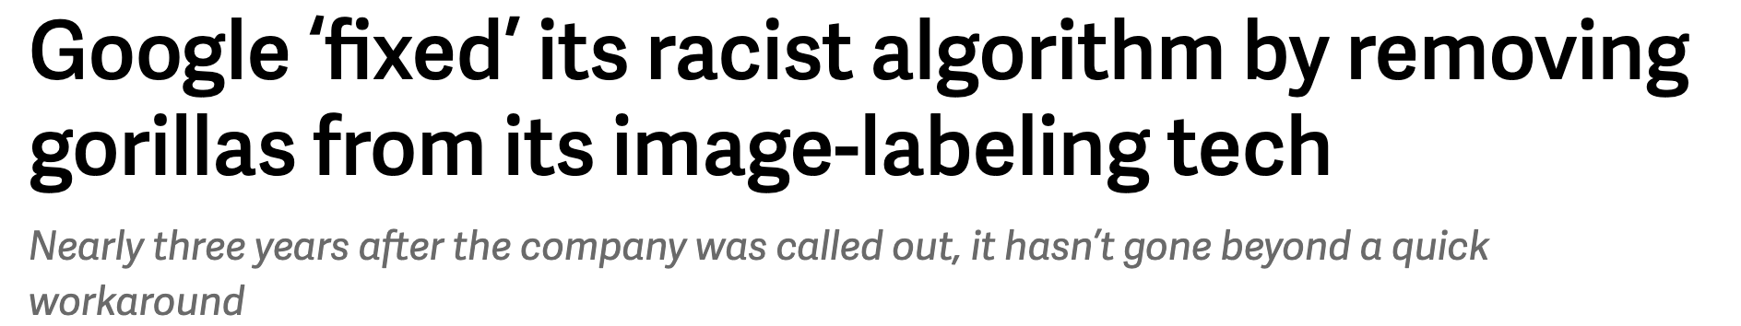
… across the industry.

Slide 21
Defining Fair
ML Fairness and Privacy

Slide 22
What is fair?
Do nothing approach:
Set the threshold the same for all a.
Equality* of…
odds: For all y, same P{Y^ = y | X, A=a, Y=y} for all a
opportunity: same P{Y^ = 1 | X, A=a, Y=1} for all a
opportunity^: same P{Y = 1 | X, A=a, Y^=1} for all a
outcomes: same P{Y^ = 1 | X, A=a} for all a
where a is the variable where fairness is in question
* Equality of Opportunity in Supervised Learning (Hardt, Price, Srebro, 2016)
Notes:
A is attributes, and y \in {0,1}
use bank loans as example
http://research.google.com/bigpicture/attacking-discrimination-in-ml/
Equality of odds:
Equalized odds is satisfied provided that no matter whether an applicant is a Lilliputian or a Brobdingnagian, if they are qualified, they are equally as likely to get admitted to the program, and if they are not qualified, they are equally as likely to get rejected.
https://developers.google.com/machine-learning/glossary/fairness#equalized_odds
Equality of opportunity:
Equality of opportunity is satisfied for the preferred label of "admitted" with respect to nationality (Lilliputian or Brobdingnagian) if qualified students are equally likely to be admitted irrespective of whether they're a Lilliputian or a Brobdingnagian.
https://developers.google.com/machine-learning/glossary/fairness#equality_of_opportunity
Equality of of outcomes:
The same fraction of Lilliputians and Brobdingnagians are admitted, regardless of the number of true positives

Slide 23
Equality of odds
P{Y^ = 1 | X, A=a, Y=1} is the same for all a
P{Y^ = 0 | X, A=a, Y=0} is the same for all a
Implication?
Notes:
Note: Holds for Y being more than binary too

Slide 24
Equality of odds
P{Y^ = 1 | X, A=a, Y=1} is the same for all a
P{Y^ = 0 | X, A=a, Y=0} is the same for all a
Implication:
accuracy of the classifier is consistent across all subgroups of interest
consistency in the quality of prediction across subgroups

Slide 25
Equality of opportunity
Same P{Y^ = 1 | X, A=a, Y=1} for all a
Implication?

Slide 26
Equality of opportunity
Same P{Y^ = 1 | X, A=a, Y=1} for all a
Implication:
weaker form of the previous, caring only about a single output class (though often used as a synonym in a binary classification environment)

Slide 27
Equality of outcomes
Same P{Y^ = 1 | X, A=a} for all a
Implication?

Slide 28
Equality of outcomes
Same P{Y^ = 1 | X, A=a} for all a
Implication:
we want the same fraction of positive outcome predictions for each subgroup, without care as to the number of true positives.

Slide 29
What do we do about it?
Decide which notion of fairness makes the most sense for your project
Measure* and iterate!
* https://github.com/tensorflow/model-analysis/blob/master/tensorflow_model_analysis/addons/fairness/post_export_metrics/fairness_indicators.py

Slide 30
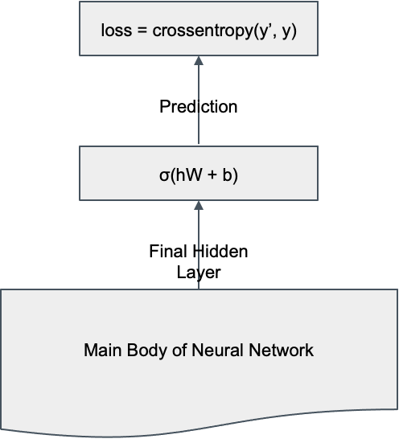
Idea: debias the output
Normal NN training configuration using cross entropy loss
Notes:
https://arxiv.org/pdf/1707.00075.pdf

Slide 31
Idea: debias the output
σ(hW₂ + b₂)
bias_loss = crossentropy(Z’, Z)
Main Body of Neural Network
Final Hidden Layer
σ(hW + b)
task_loss = crossentropy(y’, y)
loss = bias_loss + λ x task_loss
Prediction
What’s wrong with this setup? (Hint: after training, what information does the hidden layer try to capture?)
Notes:
https://arxiv.org/pdf/1707.00075.pdf
Z is a classification label indicating whether a protected attribute is present.

Slide 32
Idea: debias the output
Negative gradient
σ(hW₂ + b₂)
bias_loss = crossentropy(Z’, Z)
Main Body of Neural Network
Final Hidden Layer
σ(hW + b)
loss = bias_loss + λ x task_loss
Prediction
task_loss = crossentropy(y’, y)
Notes:
https://arxiv.org/pdf/1707.00075.pdf

Slide 33
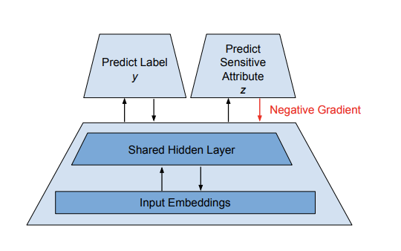
Idea: debias the output
Notes:
https://arxiv.org/pdf/1707.00075.pdf

Slide 34
Evaluation
ML Fairness and Privacy

Slide 35
What do we do about it? More (recent) ideas.
That’s hardly the only approach to either measuring or combating bias!
Winogender*: study coreference resolution systems with sentences that differ only in gender of a pronoun.
CrowS-Pairs*: Sentence pairs, one with stereotype of marginalized group, one with the group or attribute changed.
WinoMT: extension of the previous, for machine translation, including some ideas to improve bias by inserting gendered adjectives next to professions the model would otherwise start associating with one gender or the other
Model Cards: provide analysis on different slicing for clients of a ML system, allowing them to understand the bias of the current example.
Example analysis of GPT-3, finding a number of problems directly (gender-associated professions) and some by applying it to bias datasets (including Winogender).
StereoSet*: Quantitative assessment of stereotypical bias in language models
* used in next slide

Slide 36
StereoSet
Based on fill-in-the-blank tests (known as Context Association Tests or CATs)
Computes three scores:
Language Model Score (LMS)
Stereotype Score (SS), the probability of choosing a stereotype vs. an anti-stereotype, when generating text, ideally 50-50.
Idealized CAT score (ICAT)
ICAT = LMS x min(SS, 100-SS)/50

Slide 37
What do we do about it? (Fine tune!)
Starting with GPT-2 Small from Hugging Face, fine tune on union of:
Winobias / Winogender
CrowS-Pairs
Due to small fine tune dataset, experiments done by fine tuning only parts of the network:
Layer norm params (LM)
Word embeddings (WE)
Word position embeddings (WPE)
Addition of input and/or output linear transformations
https://aclanthology.org/2022.ltedi-1.8.pdf

Slide 38
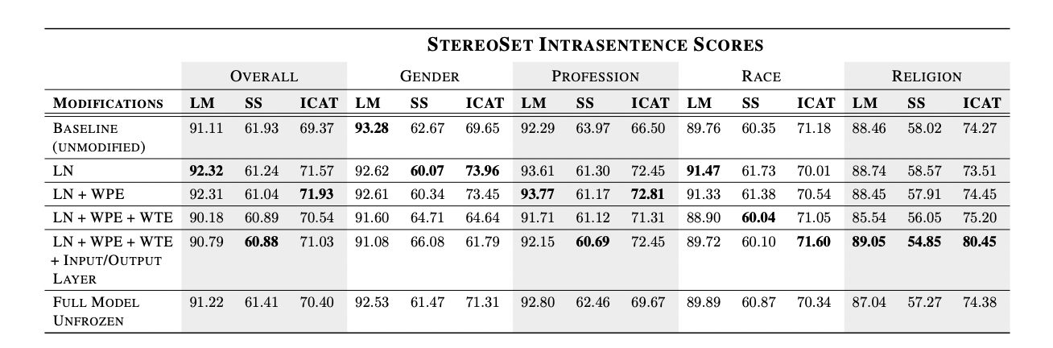
Fine tune: results!
https://aclanthology.org/2022.ltedi-1.8.pdf

Slide 39
Notebook Walkthrough
Lesson Notebook Average Diffusion Faces Diffusion Face Clustering (intersectional)
Notes:
Lesson notebook shows gender bias in large language models.
Image Bias Playground looks at how gender bias plays out with image generation systems. Try an adjective like ‘sensitive’ or ‘stubborn’ and add an occupation like ‘aide’ or ‘author’.

Slide 40
Paper Peeks
ML Fairness and Privacy
Notes:
Lesson notebook shows gender bias in large language models.
Image Bias Playground looks at how gender bias plays out with image generation systems. Try an adjective like ‘sensitive’ or ‘stubborn’ and add an occupation like ‘aide’ or ‘author’.

Slide 41
Papers
DECODING TRUST: A Comprehensive Assessment of
Trustworthiness in GPT Models

Slide 42
Privacy
Machine learning enables magic.
But it can also be a bit creepy.

Slide 43
Privacy a NLP problem?
NLP models are becoming ubiquitous in software
They can read everything you write
Without careful consideration, they might reveal information about you to companies … and loved ones!
What are examples of places you write text that you presume is private… and you definitely don’t want memorized by a model to spit back at you (or someone you know) verbatim, unexpectedly?

Slide 44
From obvious to subtle…
AOL Query Release
Search engine’s Query Suggest
Your interests and Google Activity Dashboard
Notes:
https://en.wikipedia.org/wiki/AOL_search_log_release

Slide 45
(not a course on privacy!)
Beyond machine learning and NLP, there are lots of things to worry about with privacy:
User transparency and control
Encryption
TTLs
… and so much more!

Slide 46

Idea: Data Elision
Don’t include private data in the training set…
… and think about whether your model should run on it in production.
Private Data
Public Data
What’s private? At what point might it become public?
(Hint: if enough people do something…)

Slide 47
Simplistic Technique: Thresholding
If it shows up enough times from a diverse enough set of sources (usually users), consider it public.
Questions:
Threshold units?
Threshold value?
Multiple queries?
Why might two queries on a dataset that preserve anonymity through aggregation if done individually but reveal something private if both are executed?
Assume Public
Assume Private
Threshold

Slide 48
Privacy can help!
“Privacy” to us can also be considered removal of esoteric outliers
Gradient clipping step is commonly used to protect network parameters against backpropagating a huge loss from a surprising mis-prediction
As a result*, sometimes a blind application of privacy preserving learning algorithms can help the model generalize.
Often though, the injected noise hurts model performance, disproportionately on underrepresented classes.**
* https://blog.tensorflow.org/2019/03/introducing-tensorflow-privacy-learning.html
** https://papers.nips.cc/paper/2019/file/fc0de4e0396fff257ea362983c2dda5a-Paper.pdf
Notes:
Obvious solution of randomly perturbing weights in the final network may destroy the utility of the model without any real guarantees on differential privacy
Model accuracy impact on underrepresented classes is somewhat intuitive given the effective exclusion of esoteric outliers.

Slide 49
Differential Privacy Optimizer
“Obvious” approach of adding noise to the final network parameters struggles to answer the question “how much noise?”
Potentially breaks model performance and still no real guarantees
Add two steps to usual gradient descent
Compute gradient
Clip gradient (ensures the magnitude of noise is sufficient in next step)
Add noise to gradient
Update parameters as usual, θ := θ - α * gradient
What’s the goal here?
Deep Learning with Differential Privacy
Notes:
Prevent the network from memorizing a particular example, but adding sufficient noise to the impact it has on the model parameters. (Note, it doesn’t help that the modeling team still has your private record sitting around on their hard disk… see next slide for that fix!)

Slide 50
Another approach: Federated Learning
Goal:
Don’t let the training data leave your device.
Inspiration:
Distributed training doesn’t only have to happen in a datacenter!

Slide 51
Analogous to DC Training
Saved Model Snapshots
Master
Training Job Replica
Training Data
Training Job
Replica
Parameter Servers
Training Job
Replica

Slide 52
Analogous to DC Training
Saved Model Snapshots
Master
User 1’s Phone
User 1’s Training Data
User 2’s Phone
User 2’s Training Data
Parameter Servers
User 3’s Phone
User 3’s Training Data

Slide 53
Benefits of Federated Training
Users contribute to a global model without sharing:
Features
Outcomes / choices
e.g. keyboard suggest language models.
Is this a replacement or complimentary to differential privacy aware optimization?

Slide 54
Federated Training: everything is harder
Task: Parameter search for the best dimension of hidden layer at some point in the network
Task: Try incorporating a new tensorflow op, included in the latest version of tensorflow
Problems:
Experiment sizing
Model versioning
Tensorflow versioning
Run backpropagation for many models on-device?

Slide 55
Federated Training: retrieval and signals
Task: Determine the best retrieval and ranking of a feed, e.g. TikTok.
What signals might you use?
Keeping server-side signals fresh and available to the device
Millions of candidates, how to do retrieval?
Notes:
e.g. of offline evaluation: how much more medical gore is at position 1 with the new signal vs. baseline

Slide 56
Paper Peeks/Recent Advances/Challenges
ML Fairness and Privacy

Slide 57
Extras
ML Fairness and Privacy

Slide 58
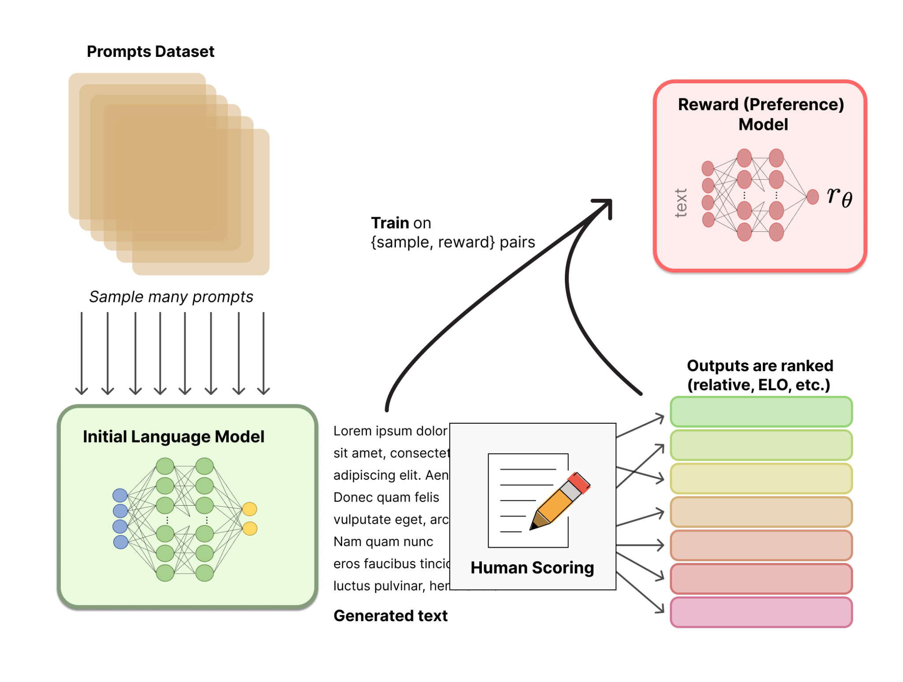
RLHF: Reward Model Training
Typically a (classifier) LLM*
https://huggingface.co/blog/rlhf

Slide 59
RLHF: Reward Model Training
Typically a (classifier) LLM*
* Literature is very unsettled on relative size of Reward model to pretrain (OpenAI >> smaller, DeepMind ~ the same size…)
https://huggingface.co/blog/rlhf

Slide 60
RLHF: Reward Model Training
Typically a (classifier) LLM*
* Literature is very unsettled on relative size of Reward model to pretrain (OpenAI >> smaller, DeepMind ~ the same size…)
https://huggingface.co/blog/rlhf

Slide 61
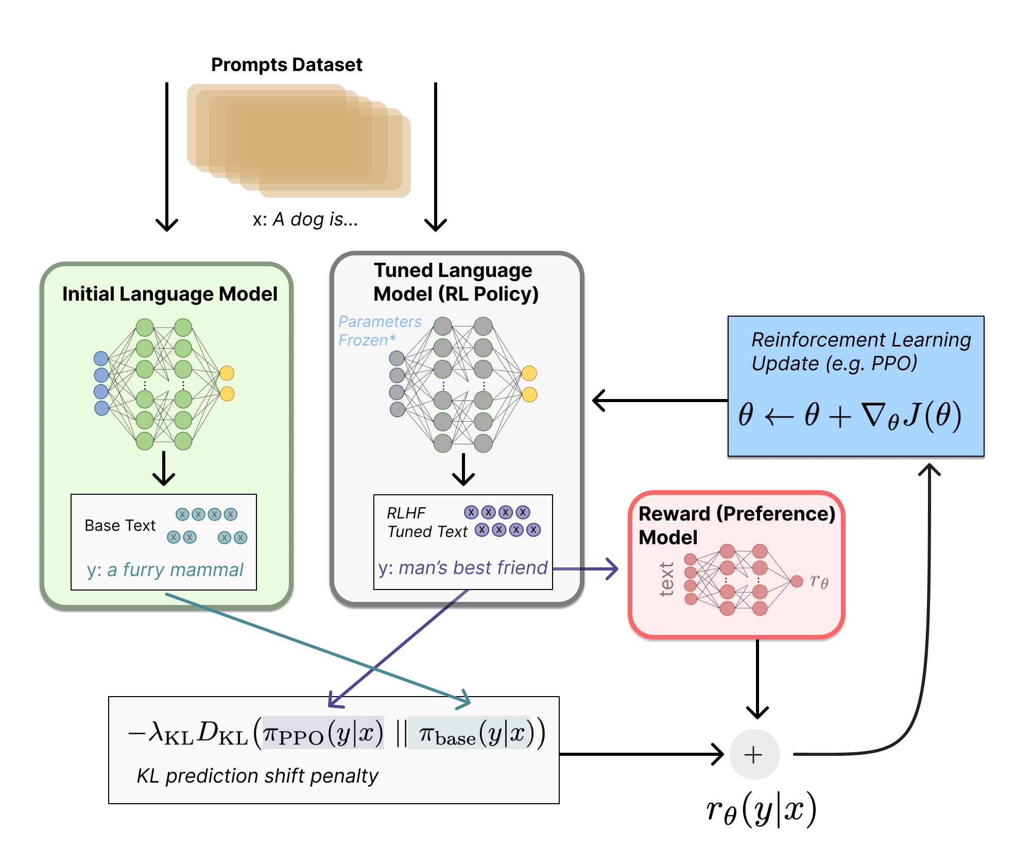
RLHF: Full RL Setup (InstructGPT)
=r_{RM}−λr_{KL}
​
https://huggingface.co/blog/rlhf

Slide 62
RLHF: Full RL Setup (InstructGPT)
RL framework
𝝅_{𝜭} = Tuned LLM
A = Vocabulary
S = Input text (prompts)
r_{𝜭}(y|x) =r_{RM}−λr_{KL}
=r_{RM}−λr_{KL}
​
https://huggingface.co/blog/rlhf

Slide 63
RLHF: Full RL Setup (InstructGPT)
RL framework
𝝅_{𝜭} = Tuned LLM
A = Vocabulary
S = Input text (prompts)
r_{𝜭}(y|x) =r_{RM}−λr_{KL}
Proximal Policy Optimization (PPO) penalization term so Tuned LLM does not “game” the Reward Model
=r_{RM}−λr_{KL}
​
https://huggingface.co/blog/rlhf

